Slide 1
Tech Intro: Docker
Business Intelligence & Analytics

Slide 2
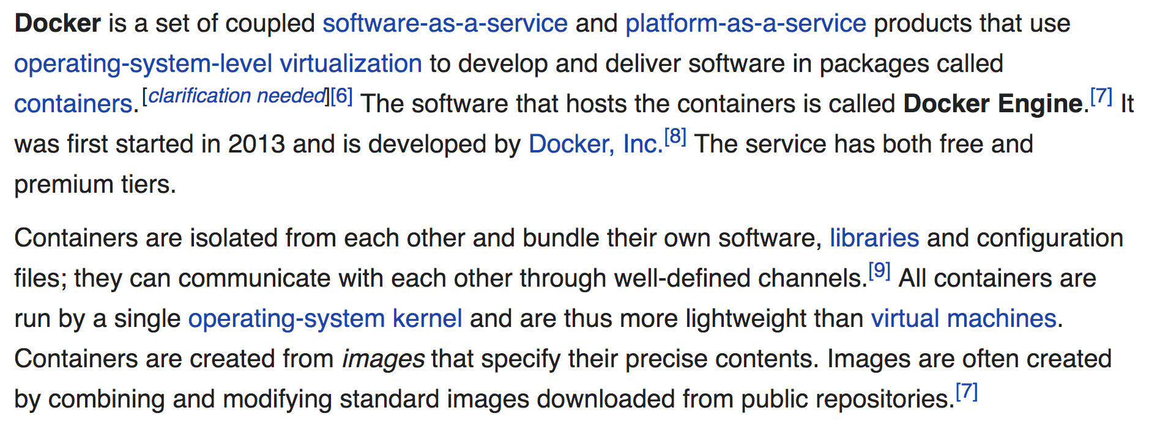
What is docker?
What does that even mean?
https://en.wikipedia.org/wiki/Docker_(software)

Slide 3
Why are we using Docker?
Install these things on your computer OR
Already have these things installed on your computer

Slide 4
What is going to happen?
On the first day of class the following will happen:
One third of the class will already have R Studio installed but…
Half of these students will be on an earlier version
Two thirds will have the wrong version of add-on packages used in the class
The other third will not have the packages installed at all
Two thirds of the class will not have it installed and…
Two thirds of them will be on Windows and will encounter all manner of issues with installation
The other third will be on Mac and will also face issues with installation
So, what are we going to do?

Slide 5
Enter docker!!!
Docker is a software program/service that allows you to create mini computers that are the same no matter where they run.
Terminology:
Image – a Docker image is the description of one of these mini computers and is generally specified using a special file called a Dockerfile.
Container – a Docker container is an image that is actually running. You create an image and then run that image to create a container. When you are finished using the container, you stop it.

Slide 6


